Slide 1
Notes:
Official permission to use the hymns posted is granted under the following conditions (a) The hymns are not to be altered in any way, (b) The hymns are to be distributed free of charge, and (c) recognition is to be given to the author and composer.
You are welcome to use or modify these PowerPoints as needed. Feel free to change the design or layout to suit your ministry, school, home, or company. More PowerPoint slides can be found at mobilehymns.org

Slide 2
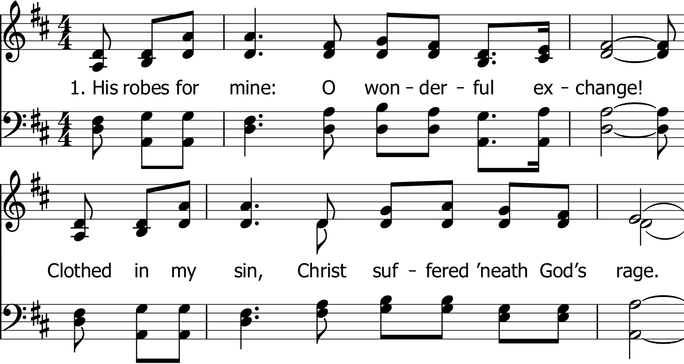

Slide 3
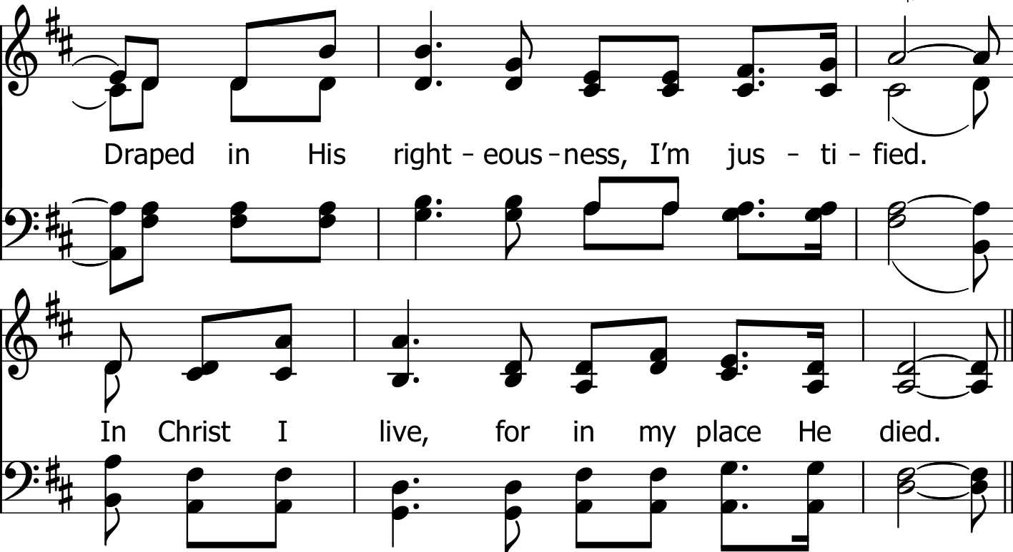

Slide 5
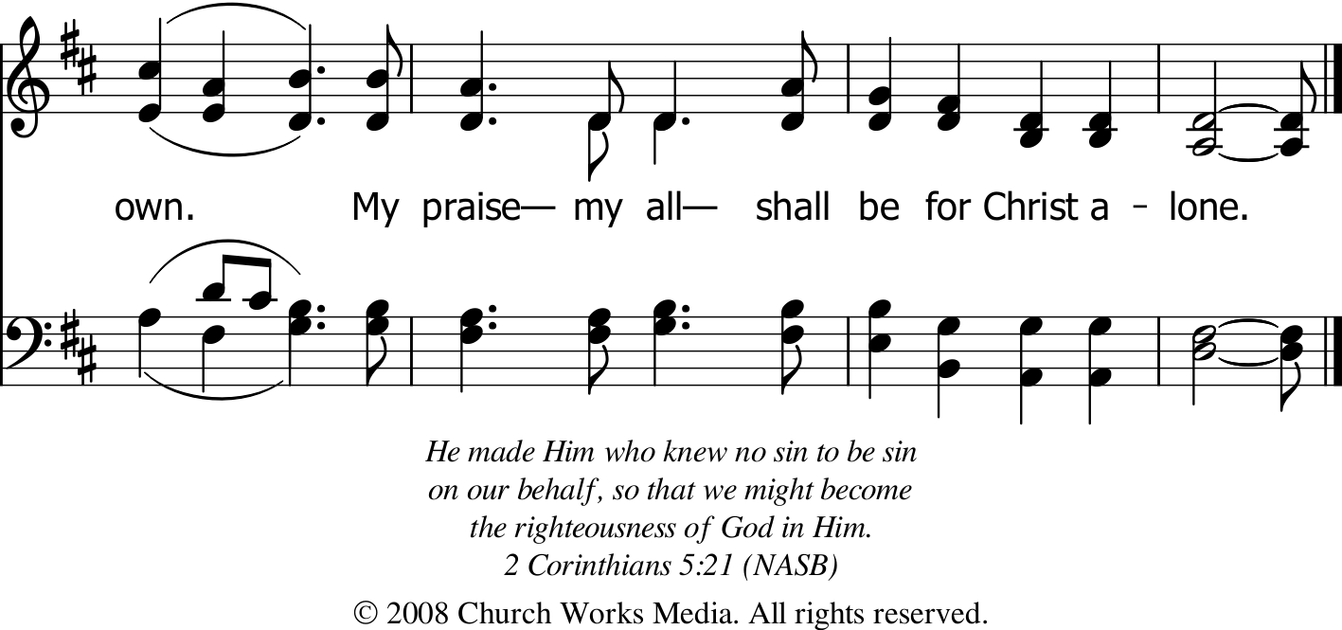

Slide 6
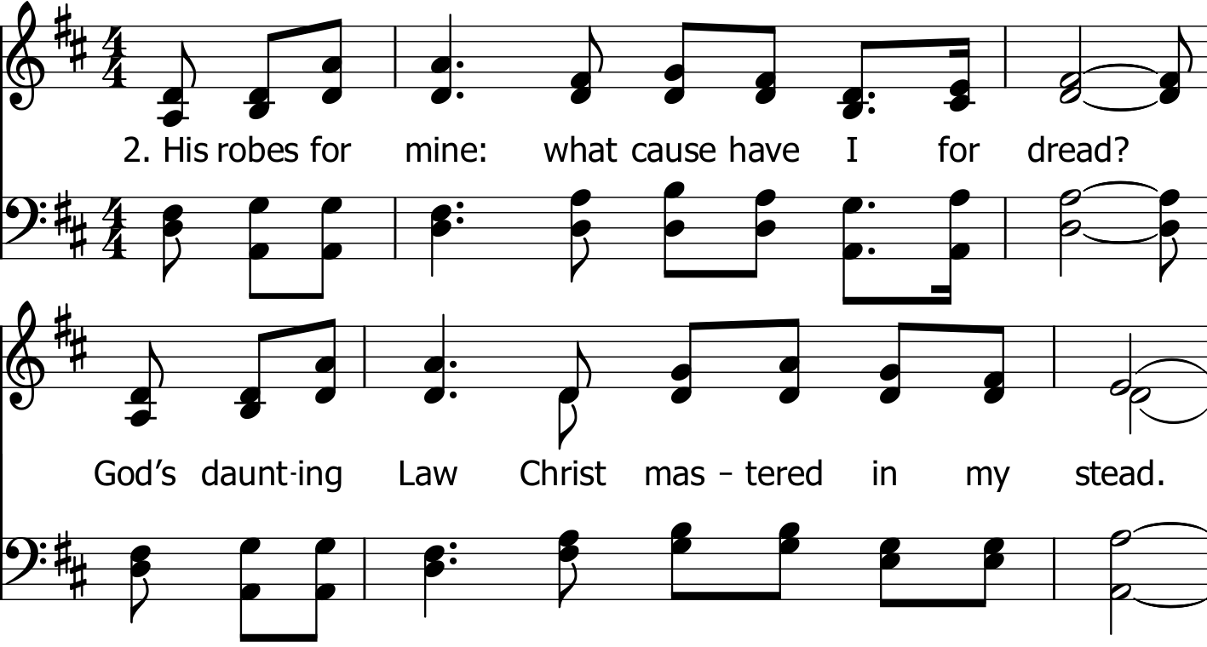

Slide 7
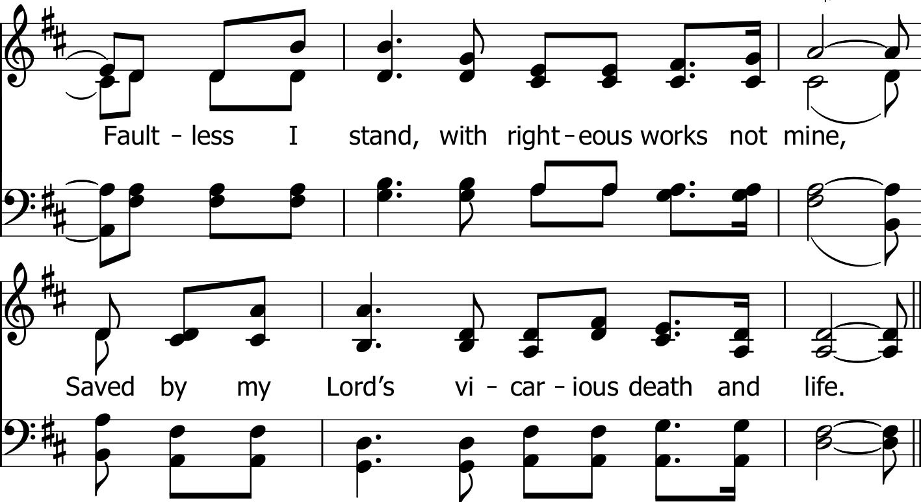

Slide 10
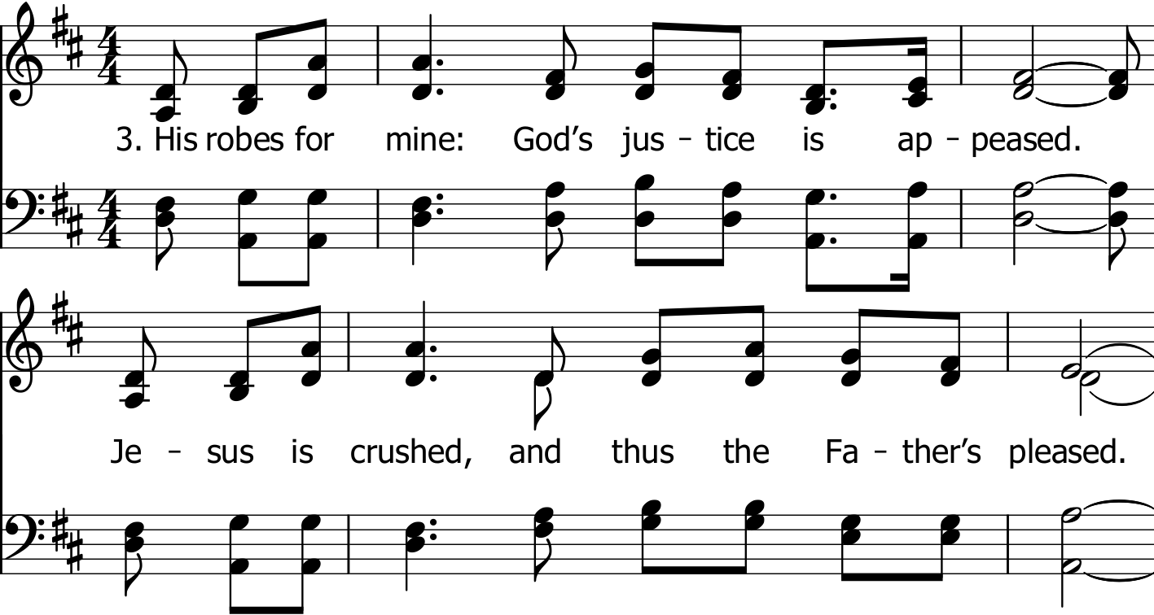

Slide 11
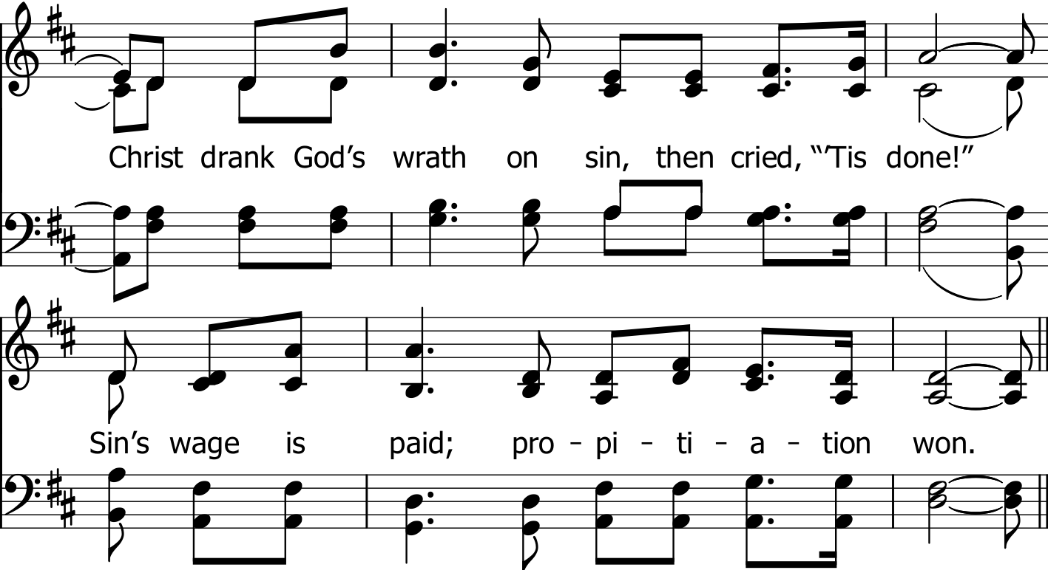

Slide 14
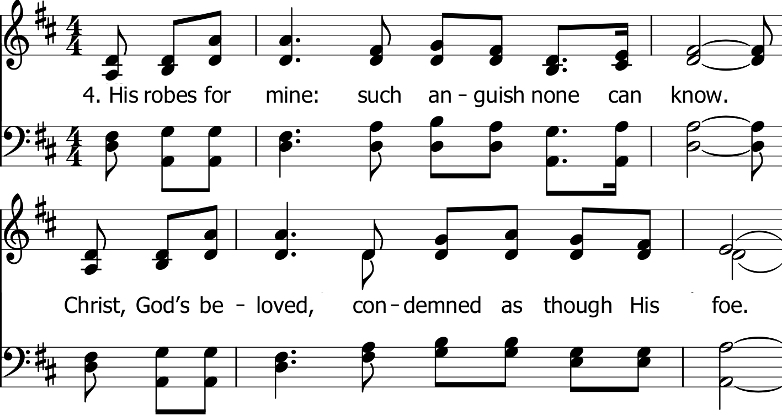

Slide 15
